Slide 1
Lecture 4a – Wine, HW, Nearest Neighbors, More Bagging
Breitzman 9/26/18

Slide 2
Wine
Last week we looked at the wine data set that is usually a DM 1 Homework assignment
Go to WineTestAgain1.doc

Slide 3
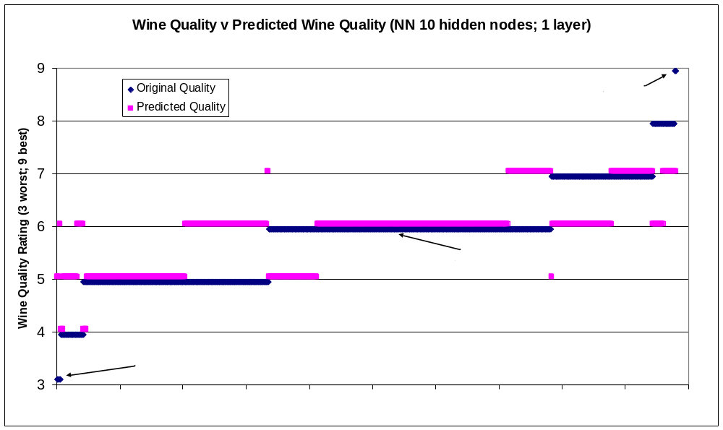
Neural Network Result Predicting 7 Classes
Does a lousy job on 3, 4, 8, 9
There is some reason for optimism: No rating is off by more than 2
A 7 wine is never rated lower than 5; a 4 is never rated above 6; a 9 is never rated below 7 etc.
Thus there is definitely some relationship between the attributes and rating

Slide 4
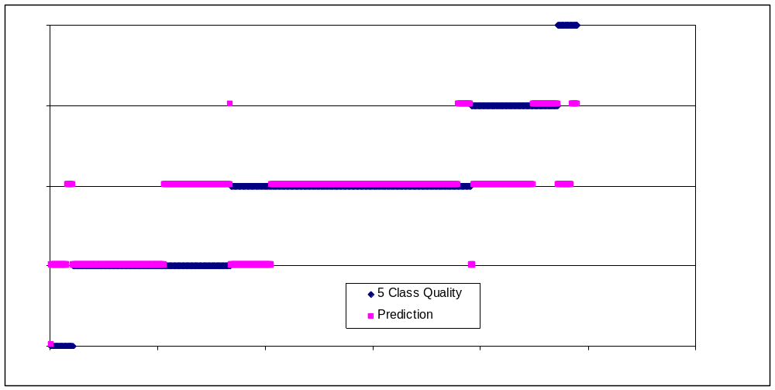
Support Vector Machine Predicting 5 Classes
Even if we go from 7 to 5 ratings, we can’t get it to predict ‘very good’
It also misses all but a few poor ratings

Slide 5
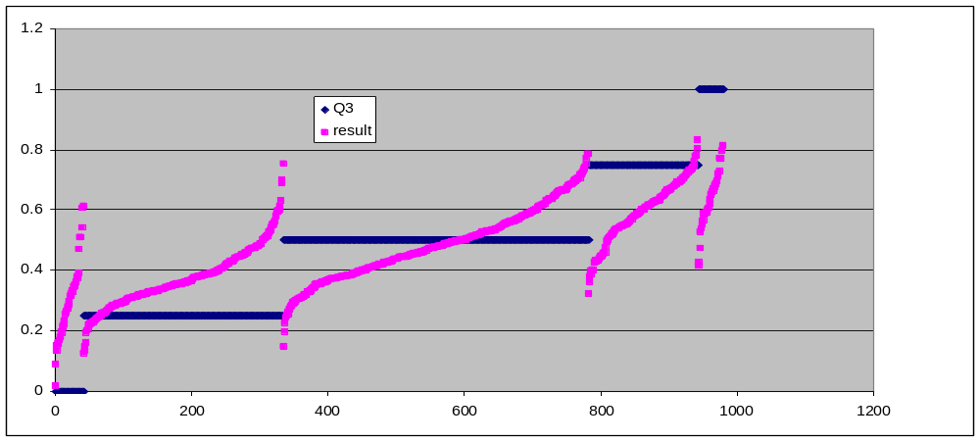
Neural Network Predicting 5 Classes
This is the raw result, which is useful to see once in your life.
In the previous case we used a rule to get an integer rating
We see that if we do that again, we will still never predict ‘very good’, and many of the ‘poor’ will be over-rated
The only good news is again, the centroids of each prediction class rise as they go right, which suggests some signal that we haven’t figured out how to capture

Slide 6
Where do we go from here?
There are a couple of approaches that we will talk about in future classes
In boosting, we will see that mis-classified training data gain weight which could help us with the 3, 8, and 9 problem
There are also methods for oversampling the minority training data
We’re not allowed to touch the testing data, but we can oversample minority data (3, 4, 8, 9) and undersample majority data (5, 6, 7) to convince the classifier that the data is evenly distributed
This is a problem that is far more common than you might think
  For example when trying to predict who might be a terrorist, the vast majority of training data will consist of people that aren’t terrorists
  Predicting who might develop a rare disease, the number of people with any given symptom who don’t have the disease will outnumber those that have it
  Predicting when a business might fail, the majority of businesses won’t fail in a given year

Slide 7
Where do we go from here (II)?
Homework: Build a better classifier than the default one discussed here.
Modifying hidden nodes will not vastly improve it and cause it to correctly predict 3, 4, 8, 9.
You should not need boosting
I have some ideas but use your own as well
  Manipulate the training data to reduce the number of 5,6,7 and increase the number of 3,4,8,9. You can actually add duplicate records to train a classifier
  Do the model in multiple stages. Predict Good wines and bad wines, then among the good try to predict 6,7,8,9 and among the bad try to predict 3, 4, 5
  Somehow combine a tree or forest with an SVM or NN to either do method A or something else
  Think up another bright idea
I don’t know if any of these will work. (I could never give this problem to an undergraduate class, because there is no linear path from problem to solution. You may try things that don’t work; that’s research)
Best 5 solutions get a 10. All reasonable attempts delivered on time get at least a 9. Try something novel and get a 10 even if it doesn’t perform very well
You may work with someone else. (Your submission should include code, an output and a word document explaining your method)

Slide 8
We’ve been talking about ensemble methods…
The next topic after bagging is usually boosting
We’ll talk about that later tonight, but I want to apply Bagging to an older method first.
I want to take a detour back to a very old method that we barely talked about in Data Mining 1: K Nearest Neighbors (KNN)
It turns out that KNN can be improved with bagging so we’ll talk about that as well

Slide 9
History Lesson
Many of the techniques we’ve been talking about are fairly recent (Bagging 1990’s; NN renaissance 1980’s, SVMs 1960’s but kernel trick 1992, etc.)
The K-Nearest Neighbor algorithm is ancient by comparison. It dates to 1951 and appears in a technical report by Emily Fix and J.L Hodges.
Intuitively easy to understand and implement
After our exercise with the wine problem where we couldn’t predict any quality 3,8, or 9 wines, I thought maybe KNN might do it

Slide 10

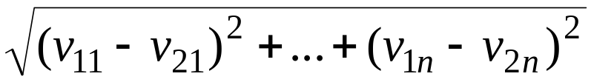
Distance Formula
Recall from high school the distance formula
This is known as Euclidean Distance and it can be extended to higher dimensions as follows
For 2 vectors of length n v₁=(v₁₁,v₁₂,v₁₃,…v_{1n}) and v₂=(v₂₁,v₂₂,v₂₃,…v_{2n}) the distance formula can be extended to

Slide 11
Wine Example
In our wine example we’ve got a bunch of vectors with 10 dimensions
Here’s the algorithm
  Take a vector from the testing set
  Compute the distance between it and all the training vectors
  Get the quality rating from the closest training vector and assign that quality to the testing vector (i.e. if our test vector is closest to a 9 then it’s a 9, etc.)
  Repeat for next vector in the test set
Actually that example is the case where k=1. If we choose k=3 we take the closest 3 vectors and take a popular vote. (If by bad luck they are all in different classes, then we are in trouble but we break ties by picking the closest)

Slide 12
KNN
Obviously the algorithm as described is potentially very slow because if we have N training vectors and M testing vectors we will be computing M*N distances of vector length dimension
There are tricks to speed it up by projecting down into lower dimension and using pre-computed distances from each training vector to rule out some cases
Also this is obviously parallelizable
Still it can be very slow for large data sets of high dimension

Slide 13
Lazy Learner
KNN is known as a “Lazy Learner”
  Because it doesn’t need to do anything with the training set until it sees a testing vector
Neural Networks, SVMs, Decision Trees, etc. are all “Eager Learners” because they do a lot of processing of the training data before seeing any testing data (e.g. a Neural Network takes a while to build but runs testing data very quickly)
Lazy learners by contrast take no time to train, but can be slow to test

Slide 14
Bagging
Remember when we talked about Random Forests we talked about Bagging
Bagging involved taking a random sample of training data as well as a random sample of the attributes and running the algorithm a bunch of times
This was a way of identifying important attributes within the vector
The same method can be used with KNN and it sometimes helps

Slide 15
Optimal Weighting
Another improvement on KNN is deceptively simple
The original algorithm used simple majority voting.
  For example if k=5, and 3 votes were for ‘9’, and 2 votes were for ‘8’ then ‘9’ wins.
But what if the three ‘9’ votes were much further away than the two ‘8’ votes? Is that fair? It would be better if we weighted the votes by the relative distances
There are about 10 million papers on what the optimal weighted voting should be. Some are quite complicated, but all use the same basic idea

Slide 16
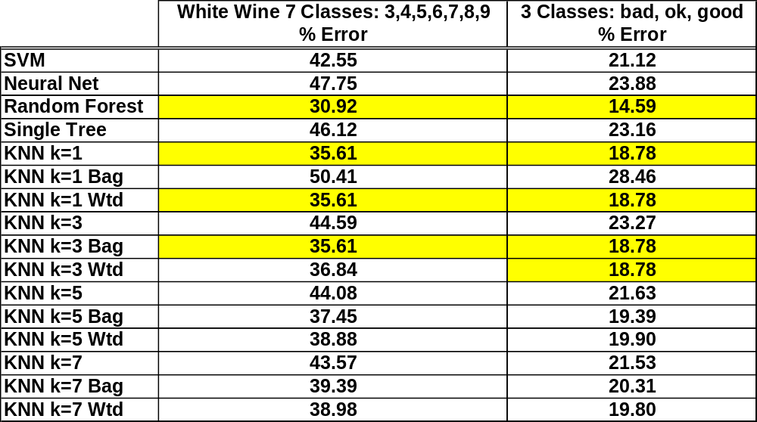
Wine Testing
Go to wineTestAgain3a.doc
Results:

Slide 17
Errors
Note that the absolute errors for the wine prediction were not bad because it correctly predicted most of the 5’s, 6’s, and 7’s and that’s what most of the wines were
When we looked at percent error the error rate looked a lot worse
How can this be? Suppose we have 1000 wines and 600 are correctly classified, 200 are off by 1 category, and 200 are off by 2 categories. Percent error is 40%, but absolute error is
(600*0 + 200*1 + 200*2)/1000 = .5. This gives the illusion that on average if the model predicts 7.3 then the actual quality rating is between 6.8 and 7.8, but that need not be the case
One of these days (but not today) we will talk about different error calculations and pros and cons of each

